Slide 1
MISSION STATEMENT
TEAM 08
NULEEP
FCR ARB REVIEW
12/10/2020

Slide 2
IIV&V

Slide 3

Team Analysis
Strengths
Strong communications skills
Complete transparency with the client
Group of students with diverse technical skills
What is the team lacking at the moment?
No one in the team has React experience
Not taking enough risks

Slide 4
Concerns and Proposed Solutions
Running into issues while integrating the COTS with the app
SOLUTION:
We’ve only been at it for a week. Some more time should help us get a breakthrough.
Work alongside the Nuleep Dev team to resolve issues.

Slide 5
OCD

Slide 6
System Purpose
The Nuleep chat system is designed to provide instant chat functionalities between users and recruiters.
Our clients, Nuleep, believe that the system will provide critical functionalities that allow the app to provide uniques features (audio & video conferencing) that stands out from competitors such as Jumpstart.

Slide 7
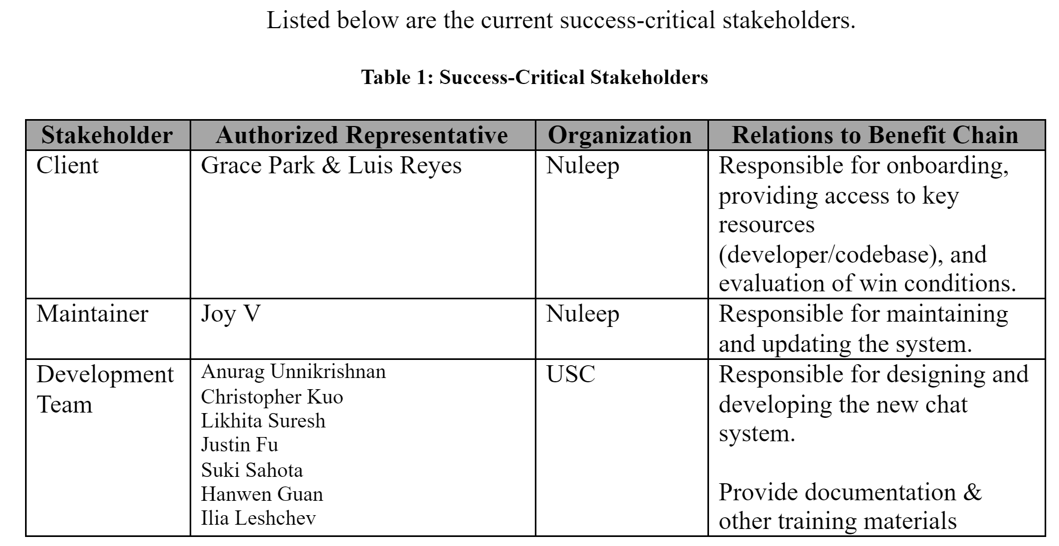
Shared Vision
Success-critical stakeholders
System Capabilities Description
Expected Benefits
Benefit Chain, System Boundary
and Environment

Slide 8
System Capabilities And Description
Text, audio and video messaging system
Allows Nuleep to stand out from competitors such as Jumpstart
Targets job seekers and corporate recruiters
These features will be integrated to the mobile app using Twilio, a COTS messaging service

Slide 9
Expected Benefits
Users can directly chat with both recruiters from desired companies and fellow job seekers.
Recruiters can quickly select and reach qualified candidates through text or audio calls.
New features provide audio (possibly even video) conferencing that stands out from competitors such as Jumpstart.
Easier communications with recruiters & colleagues will improve user experience and lead to more career opportunities.

Slide 10
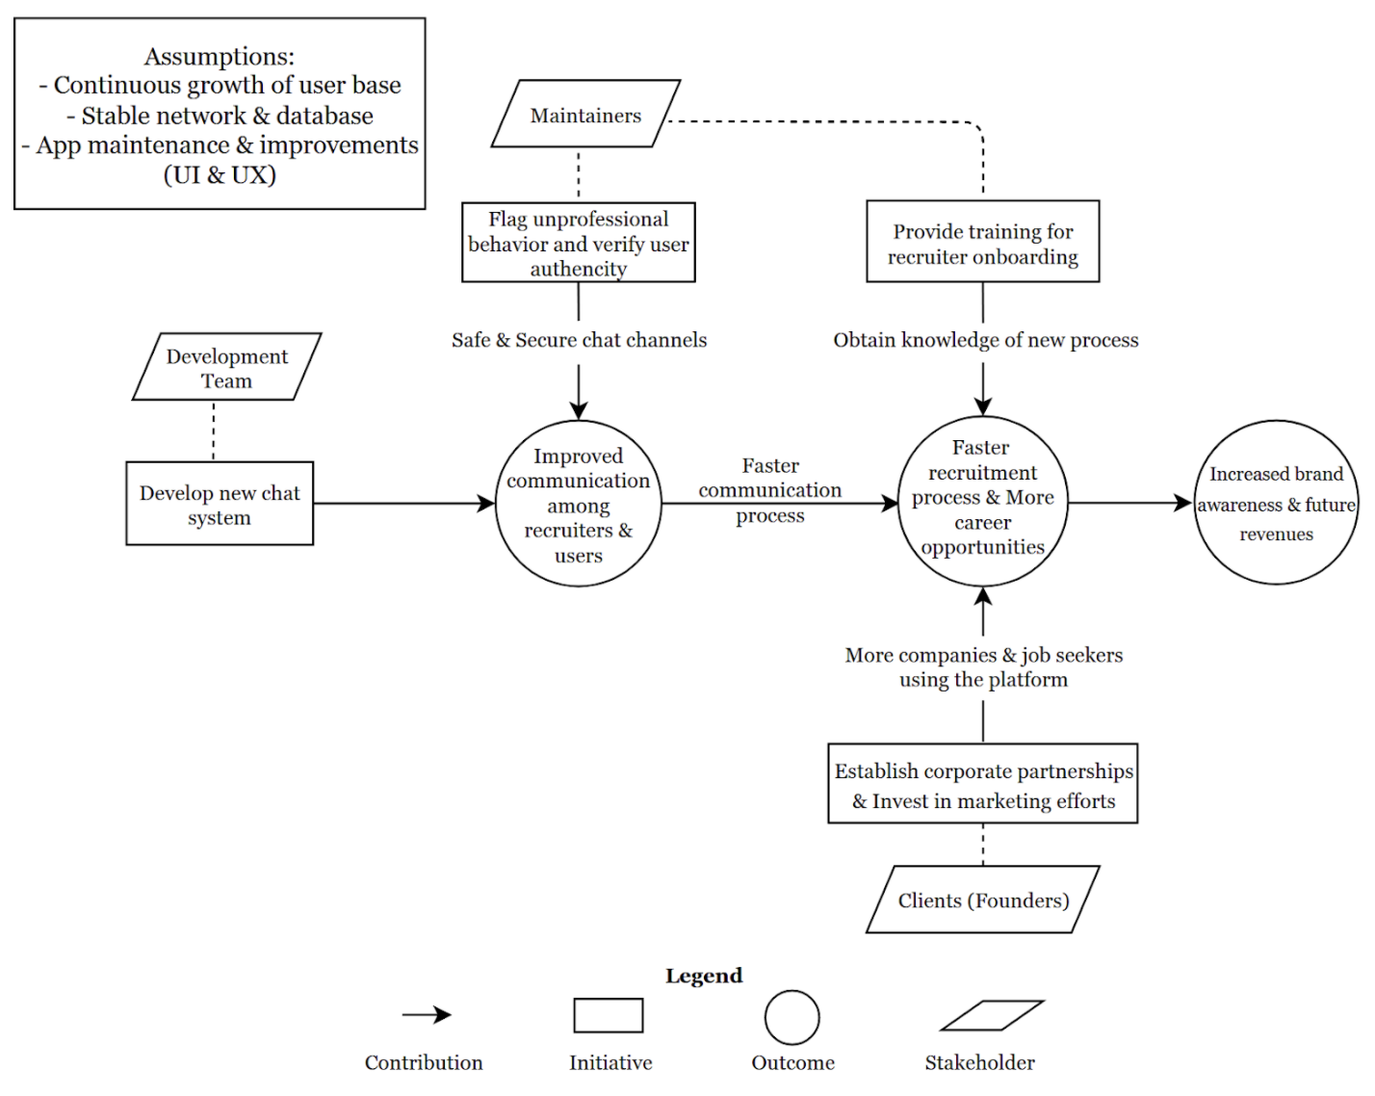
Benefits Chain

Slide 11
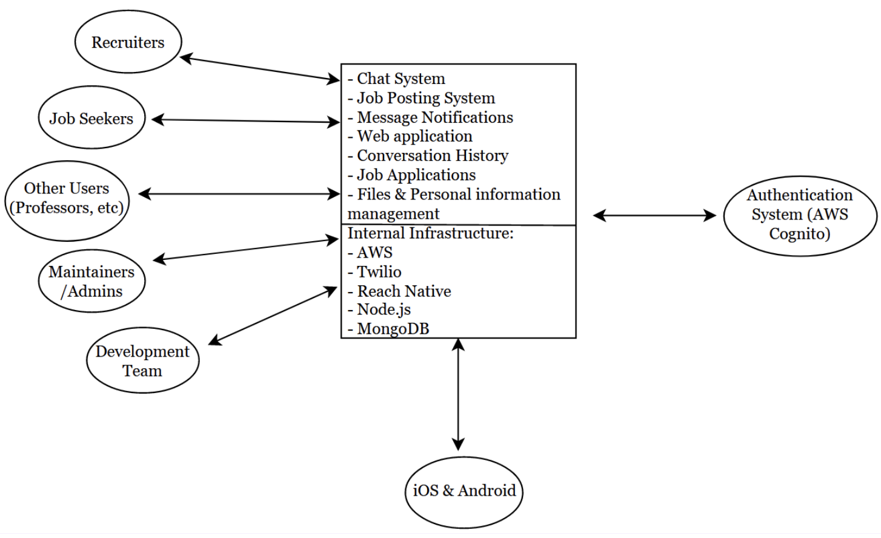
System Boundaries And Environment

Slide 12
System Constraints & Goals
Constraints
CO-1: iOS & Android & Web App: The current app must be able to run on all of the systems listed.
CO-2: Twilio: The chat system must be integrated with Twilio.
CO-3: Javascript & React Native: These two languages must be used as the development languages.
Capabilities Goals:
Instant Chat: Users, including recruiters & job seekers, must be able to send message(s) (requests), engage in audio/video conferencing, or send files to other users.
Instant Notifications: Users must be notified of incoming messages & calls through in-app or pop-up notifications.

Slide 13
REQUIREMENTS

Slide 14
Essential Requirements
Requirement | Score
As a job seeker, I will be able to chat in text, audio, or video with a recruiter if approved. | 100
As a job seeker I want to send files such as pdfs, docx, or images so that I can share them with the recruiter. | 100
As a user I want to see a notifications when a message received. | 100
As a user, I can block another user in my chat channels. | 90
As a user, I can see the status of the sent message e.g. sent/delivered/read. | 90

Slide 15
PROTOTYPE
DEMO

Slide 16
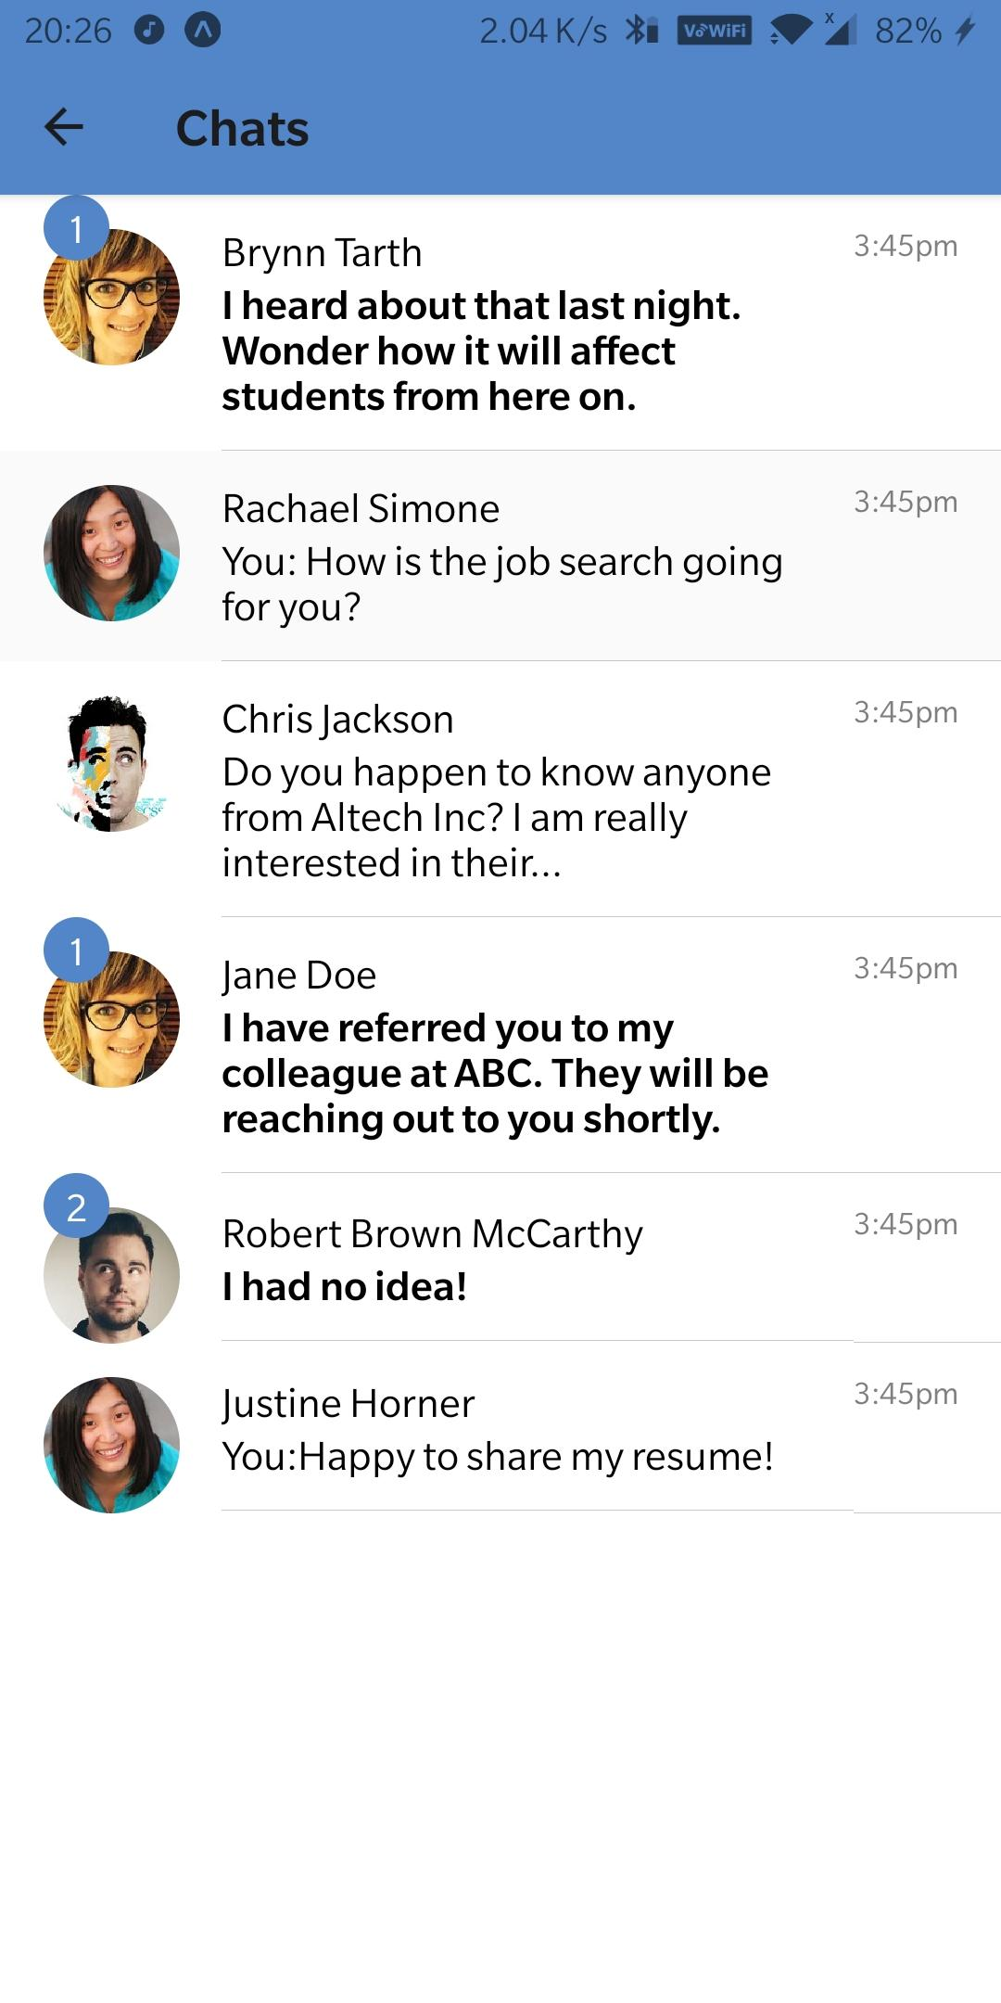
CHAT SYSTEM
Built to connect job seekers, users, and recruiters.

Slide 17
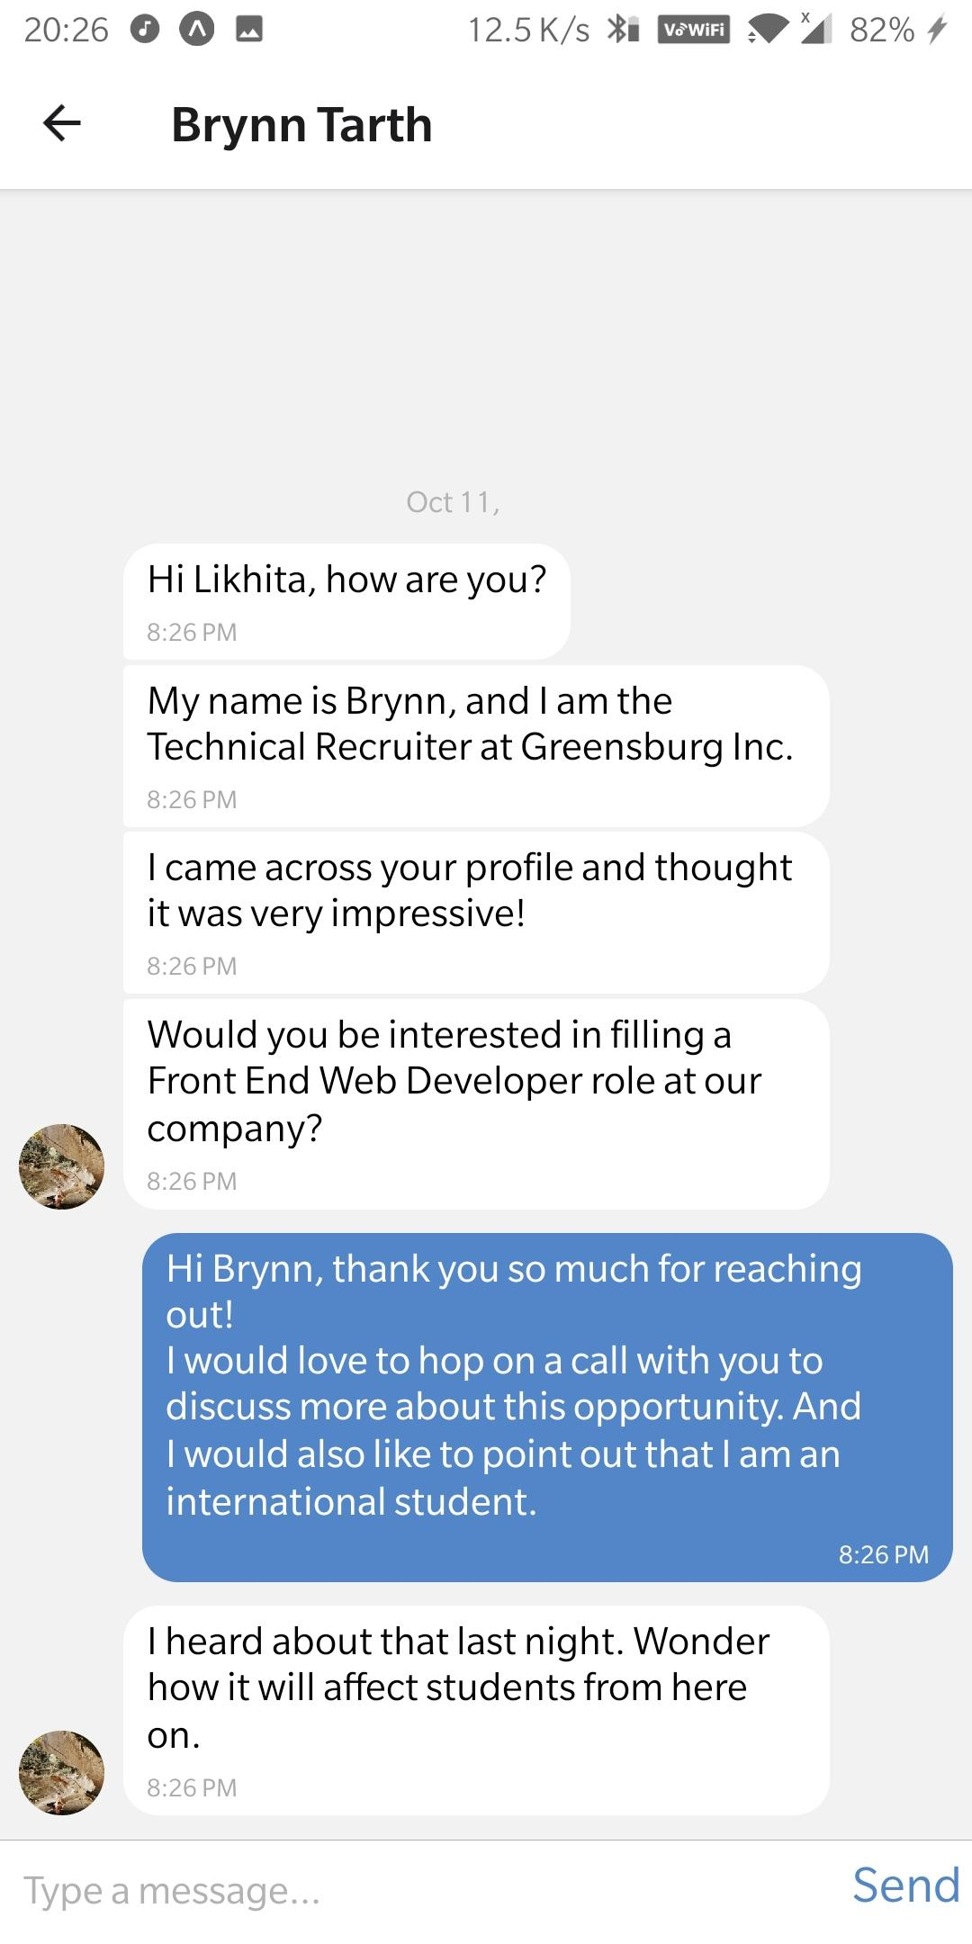
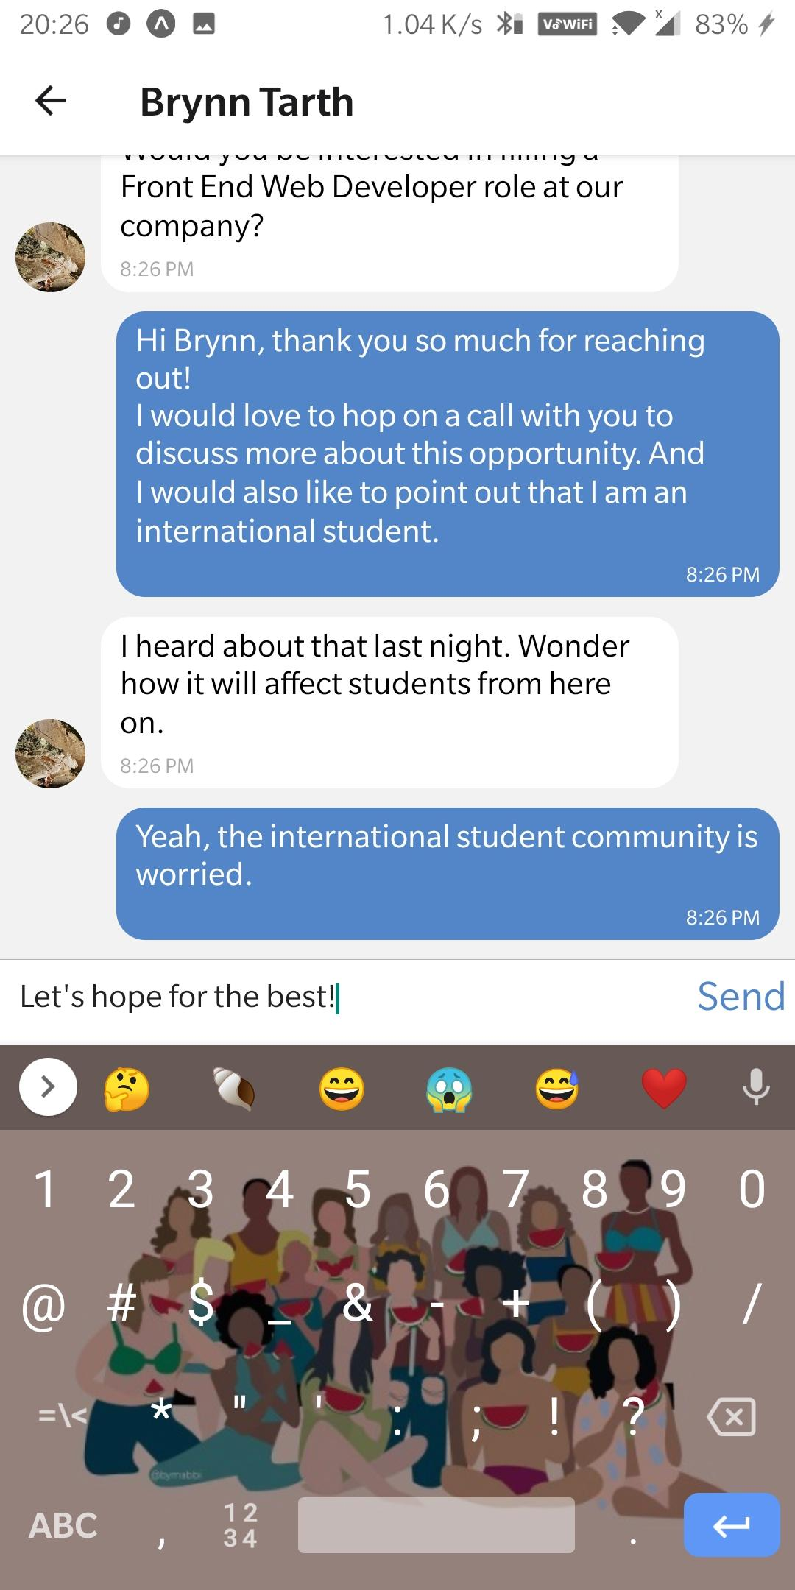
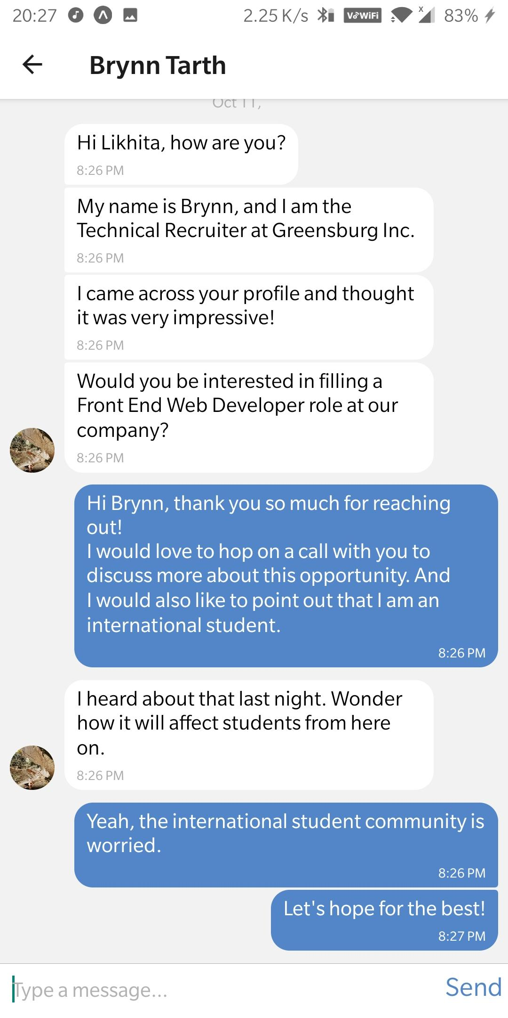
FLOW OF THE SYSTEM
CHAT LIST
CHAT VIEW
TYPE MESSAGE
MESSAGE SENT

Slide 18
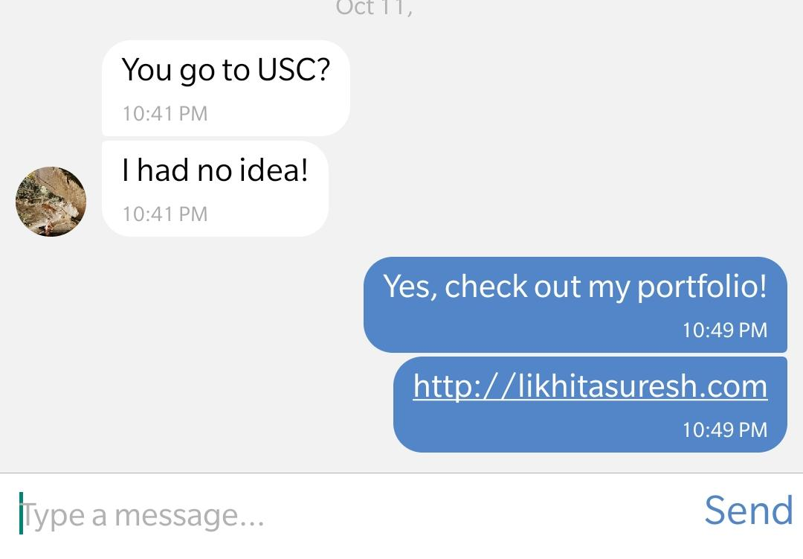
FLOW OF THE SYSTEM
LINK-ify

Slide 19
FLOW OF THE SYSTEM
BADGE AND BOLD TEXT FOR UNREAD MESSAGES

Slide 20
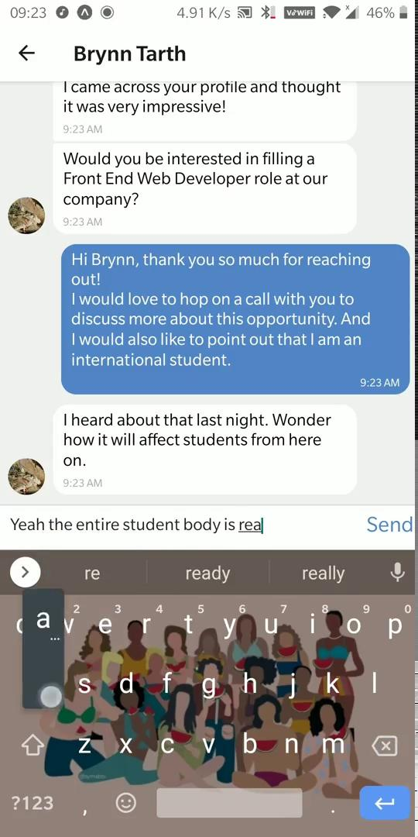
VIDEO DEMO

Slide 21
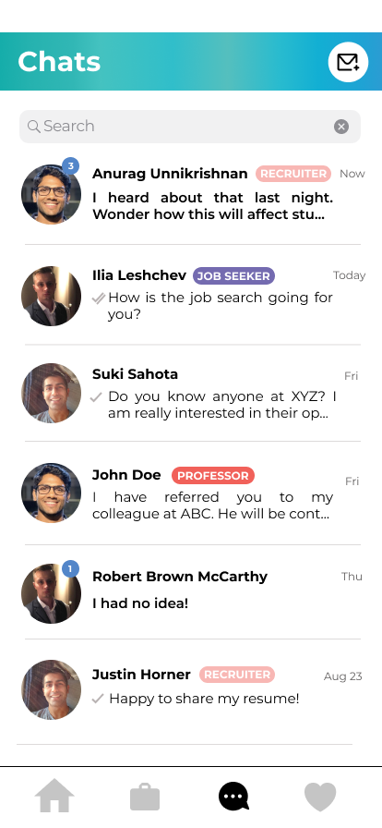
FUTURE FEATURES
Compose new chat
Search Chat
Title Badge
Automatic reordering of chats upon updation.

Slide 22
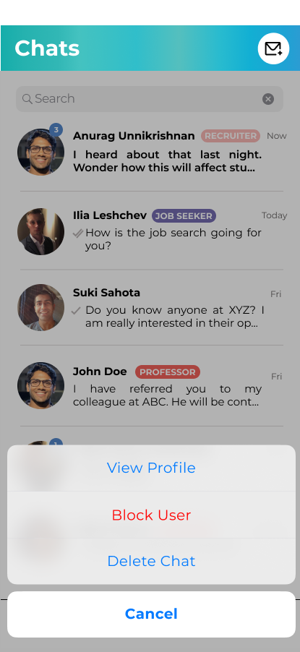
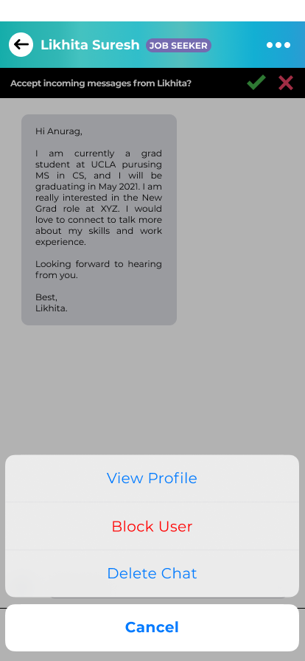
FUTURE FEATURES
Context Menu
Options Menu

Slide 23
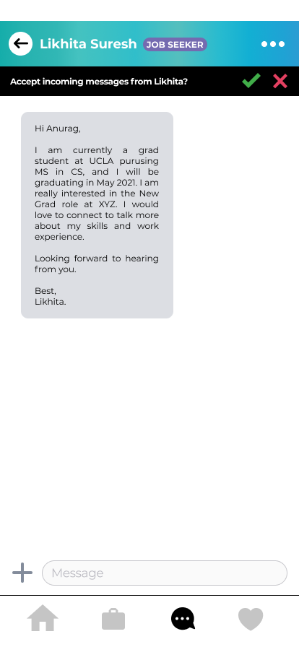
FUTURE FEATURES
Recruiter’s approval

Slide 24
ARCHITECTURE

Slide 25
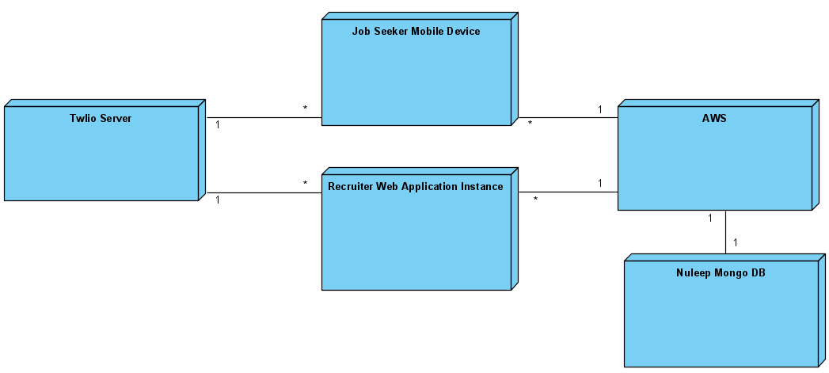
Physical Architecture

Slide 26
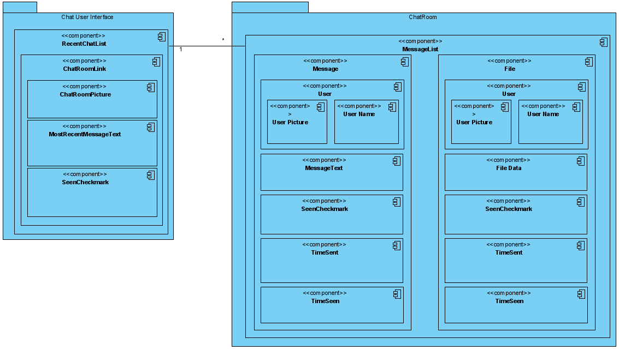
Software Architecture

Slide 27
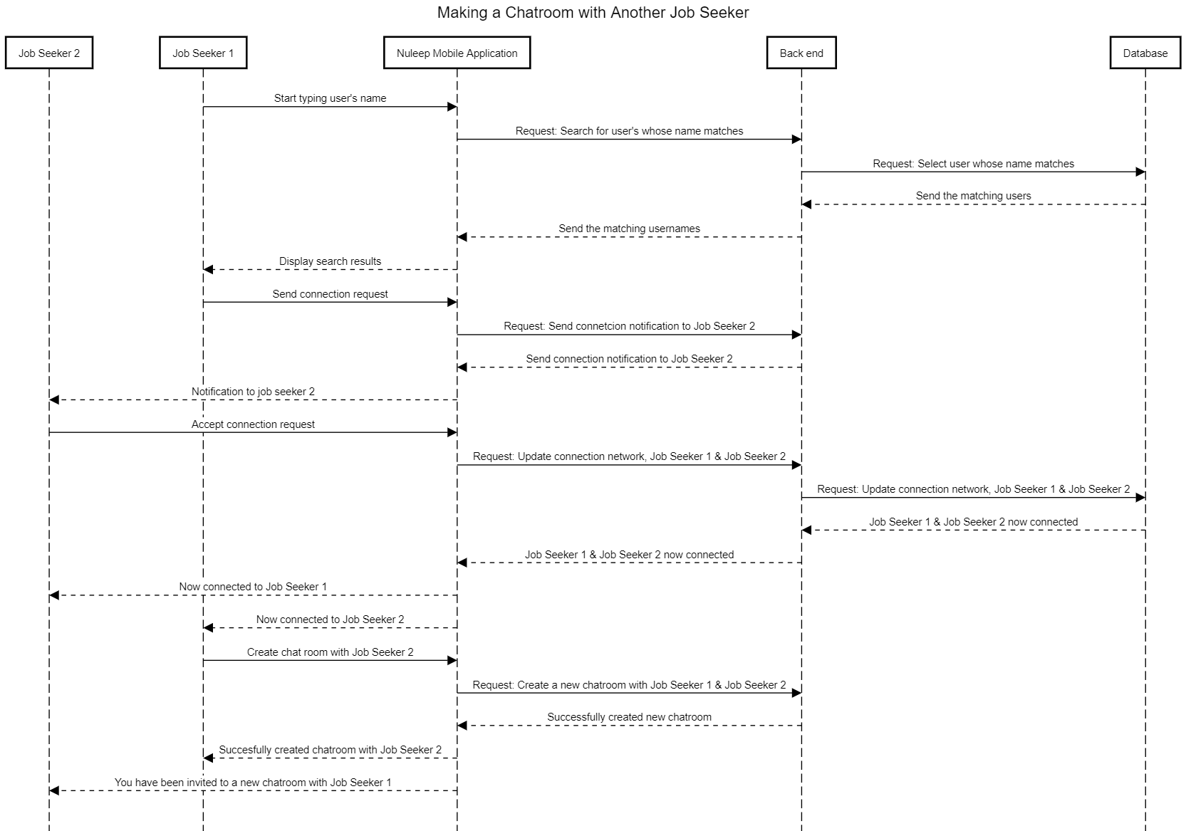
Making a Chatroom with a Connection

Slide 28
LCP

Slide 29
Lifecycle Strategy
The schedule for this project is 12 weeks, which is the Fall 2020 (CSCI 577a) semester only.
The process model implemented in this project is the Incremental Commitment Spiral Model (ICSM).
One core capability, Referral System, is deferred.
The Nuleep System is following a COTS/Services intensive process because there is a Non-Developmental Item (NDI) or Web service that fits most of the core capabilities.

Slide 30
Development Increment 1
Development phase – Development Increment 1
Deliverables: Executable Chat System, Core Capability Drive-through report
Milestone: Core Capability Drive-through (Nov. 6)
Strategy: One Incremental Commitment Spiral Model Cycle

Slide 31
Development Increment 2
Development phase - Development Increment 2
Deliverables: Executable system, Initial Operational Capability Working Set, Transition Package
Milestone: Transition Readiness Review (Nov. 16)
Strategy: One Incremental Commitment Spiral Model Cycle

Slide 32
Transition Increment
Deliverables: System Installation, Operations Commitment Package, Transition Package
Milestone: Operation Commitment Review (Nov. 20), Close Out Report
Strategy: One Incremental Commitment Spiral Model Cycle

Slide 33
Stakeholder Responsibilities
Anurag Unnikrishnan: Project Manager / Feasibility Analyst
Likhita Suresh: Prototype Engineer / Implementer
Christopher Kuo: Software Architect / Coder
Ilia Leshchev: Requirements Engineer / Tester
Justin Fu: Operational Concept Engineer / Requirements Engineer
Suki Sahota: Lifecycle Planner / Operational Concept Engineer
Hanwen Guan: Software Architect / Tester
Joy, Luis, Isidro & Grace (Nuleep Team): Maintainers

Slide 34
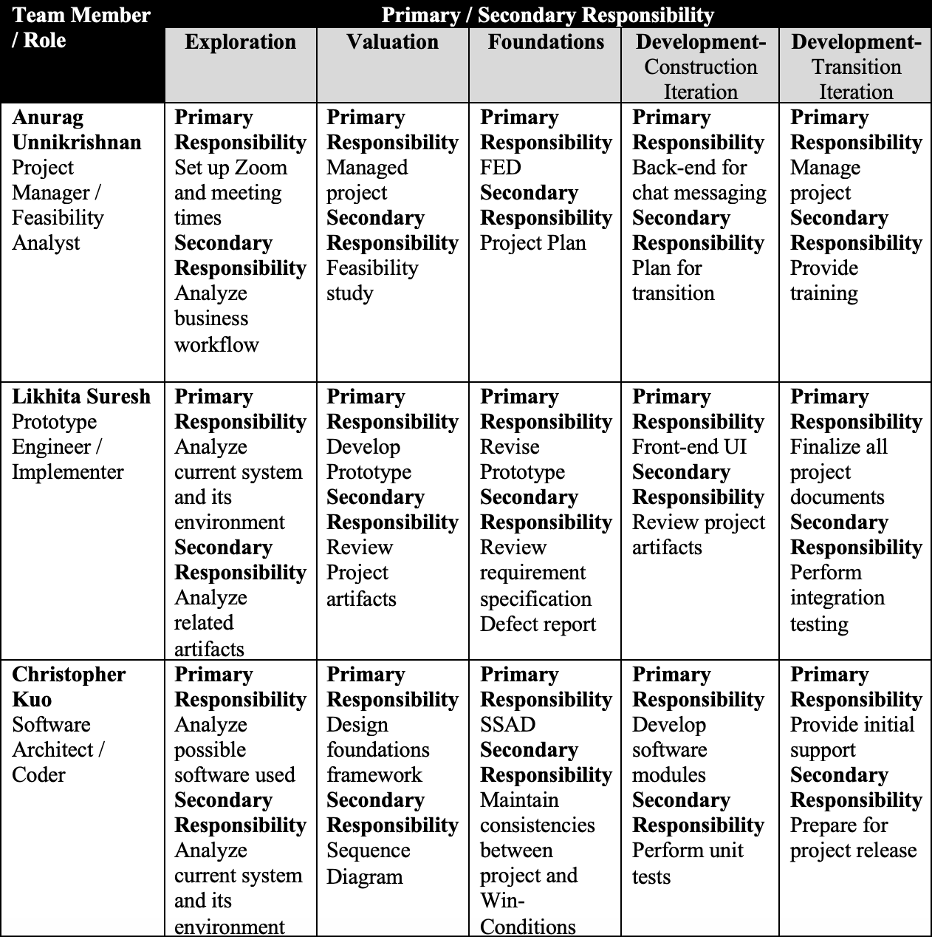
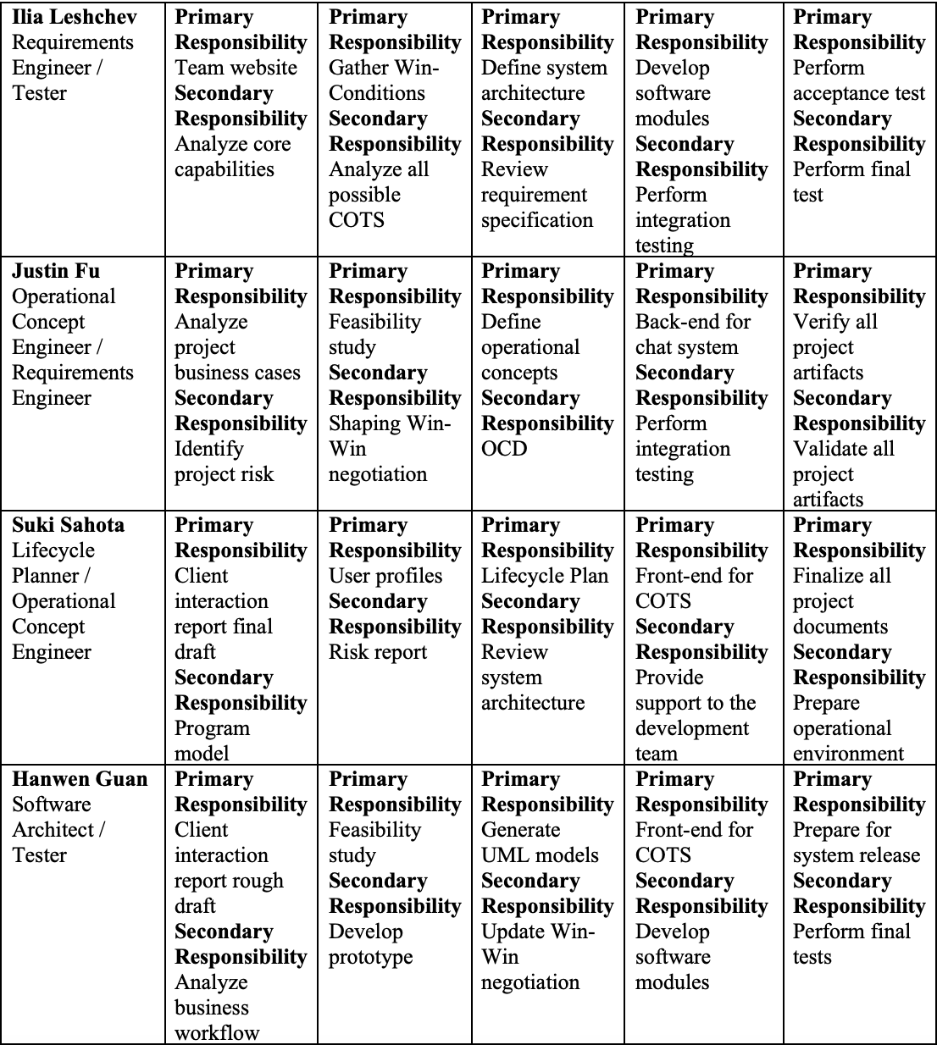
Responsibilities by Phase

Slide 35
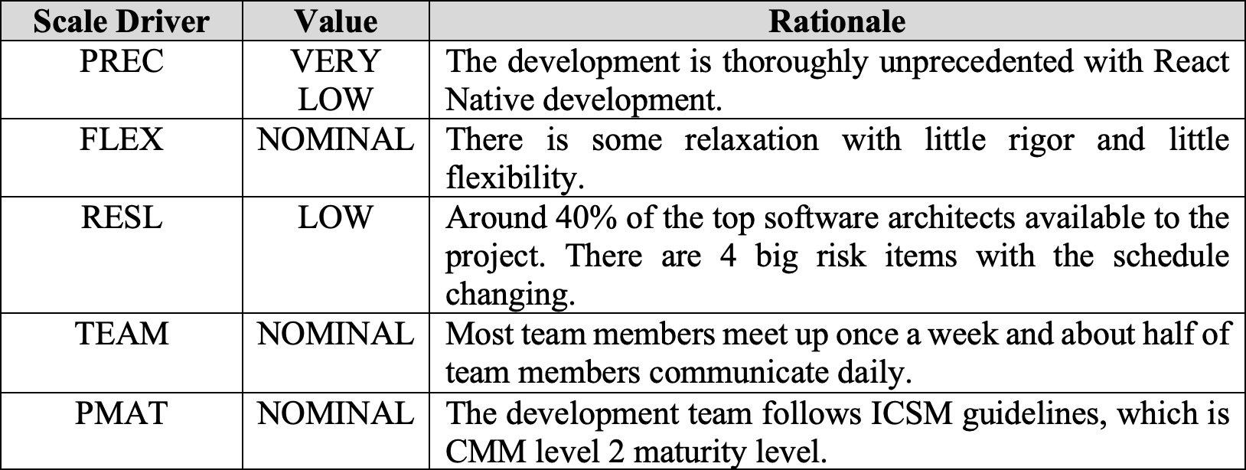
COCOMO II Scale Factors

Slide 36
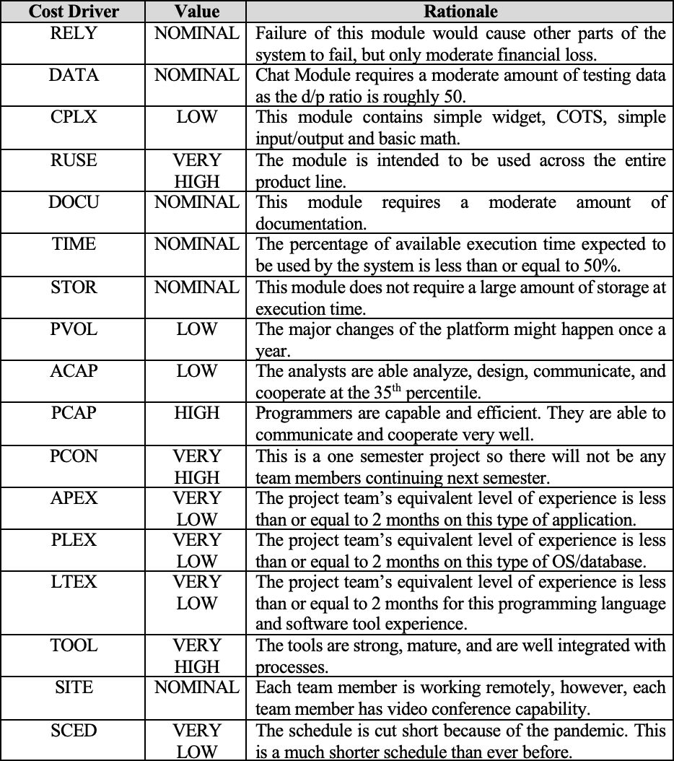
COCOMO II Cost Drivers
LCP
Only one module -- chat system

Slide 37
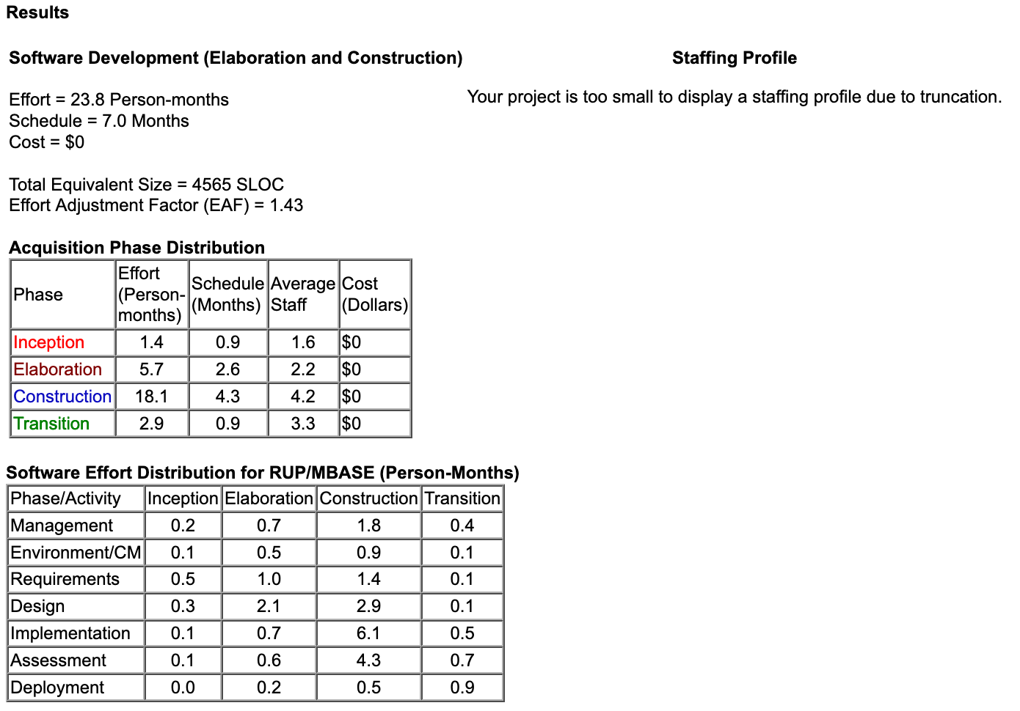
COCOMO II web-tool
LCP
Estimated 577a Effort:
Seven team members at 12 hrs./week for 12 weeks
Total estimated Effort:
1008 hours

Slide 38
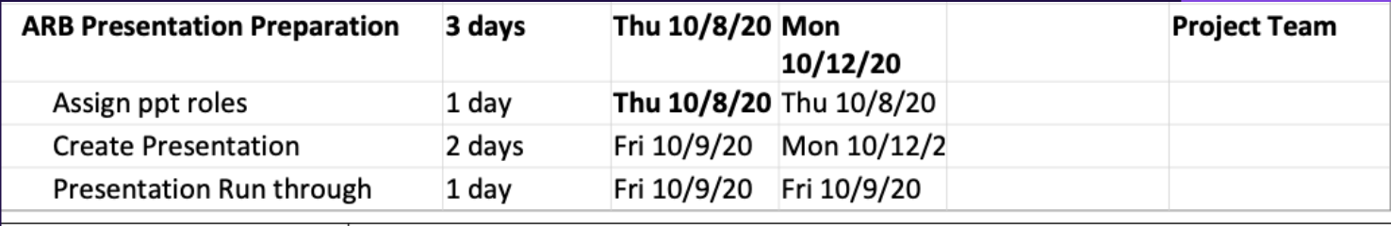
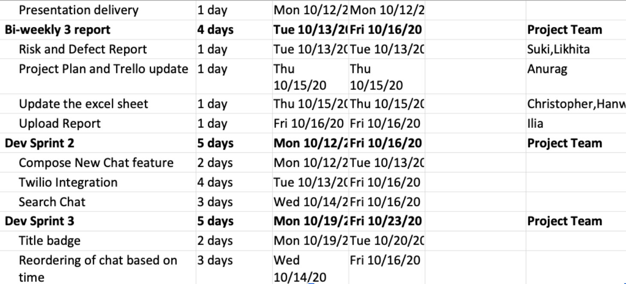
Project Plan

Slide 39
FEASIBILITY EVIDENCE

Slide 40
Why Nuleep?
Jobseekers are demotivated & disengaged
Company HR teams & Recruiters never have enough time & are demotivated
What does the Future of Work of work entail?

Slide 41
Solution and Benefits Analysis
Fast-track match to purpose driven talent with AI
Help companies with scaling & engaging their workforce.
Jobs & Industries are changing with tech

Slide 42
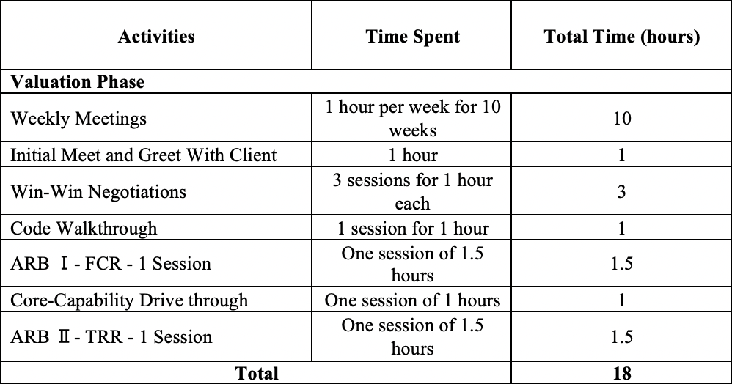
Personnel Cost
What are the client personnel costs?

Slide 43
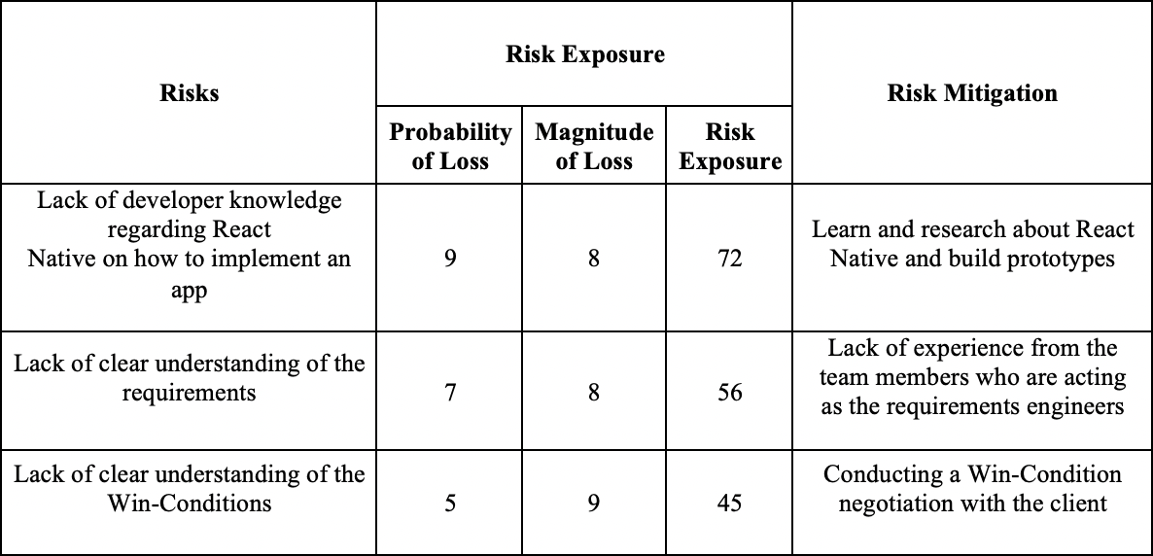
Risks
What are the risks the system faces?

Slide 44
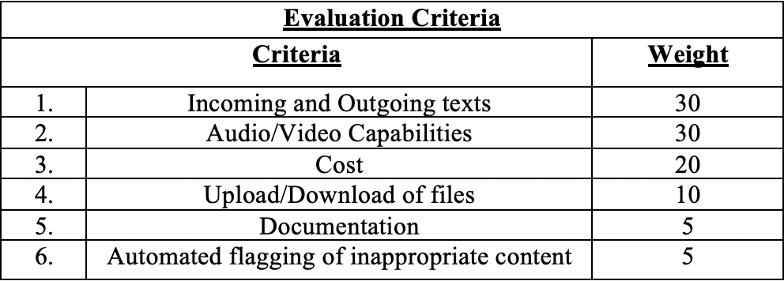
NDI Analysis
What are the various criteria based on which the chat APIs were compared?

Slide 45
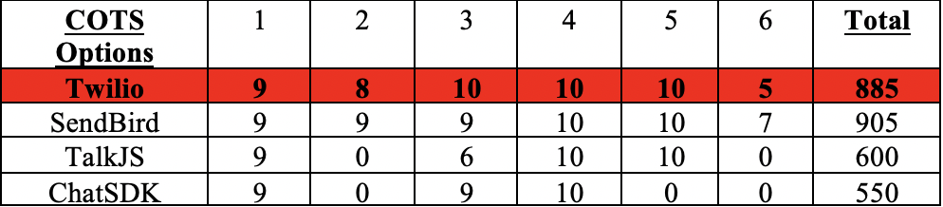
NDI Analysis
What are results after applying the weighted scores?

Slide 46
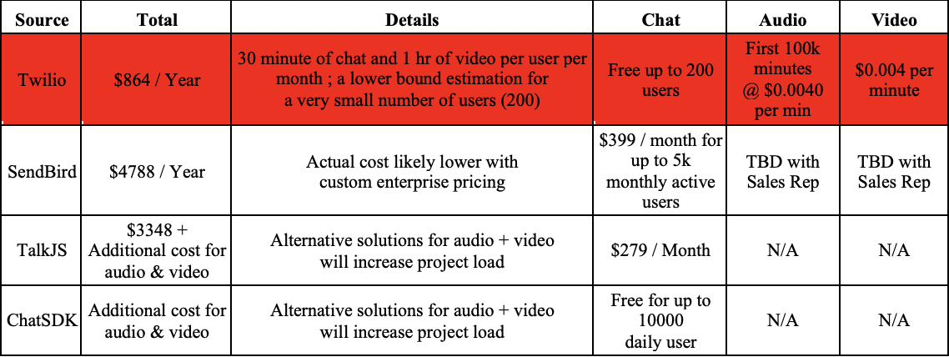
NDI Analysis
Final selection based on cost analysis -

Slide 47
LOS Feasibility Evidence
LOS 1: Accessibility
LOS 2: Effectiveness
LOS 3: Simplicity
LOS 3: Flexibility

Slide 48
Capability Feasibility Evidence
CR 1: Provide user-authentication
CR 2: Allow users to send texts to each other
CR 3: Allow recruiters to accept/deny message requests
CR 4: Allow users to audio/video call each other
CR 5: Allow users to revisit chat conversations

Slide 49
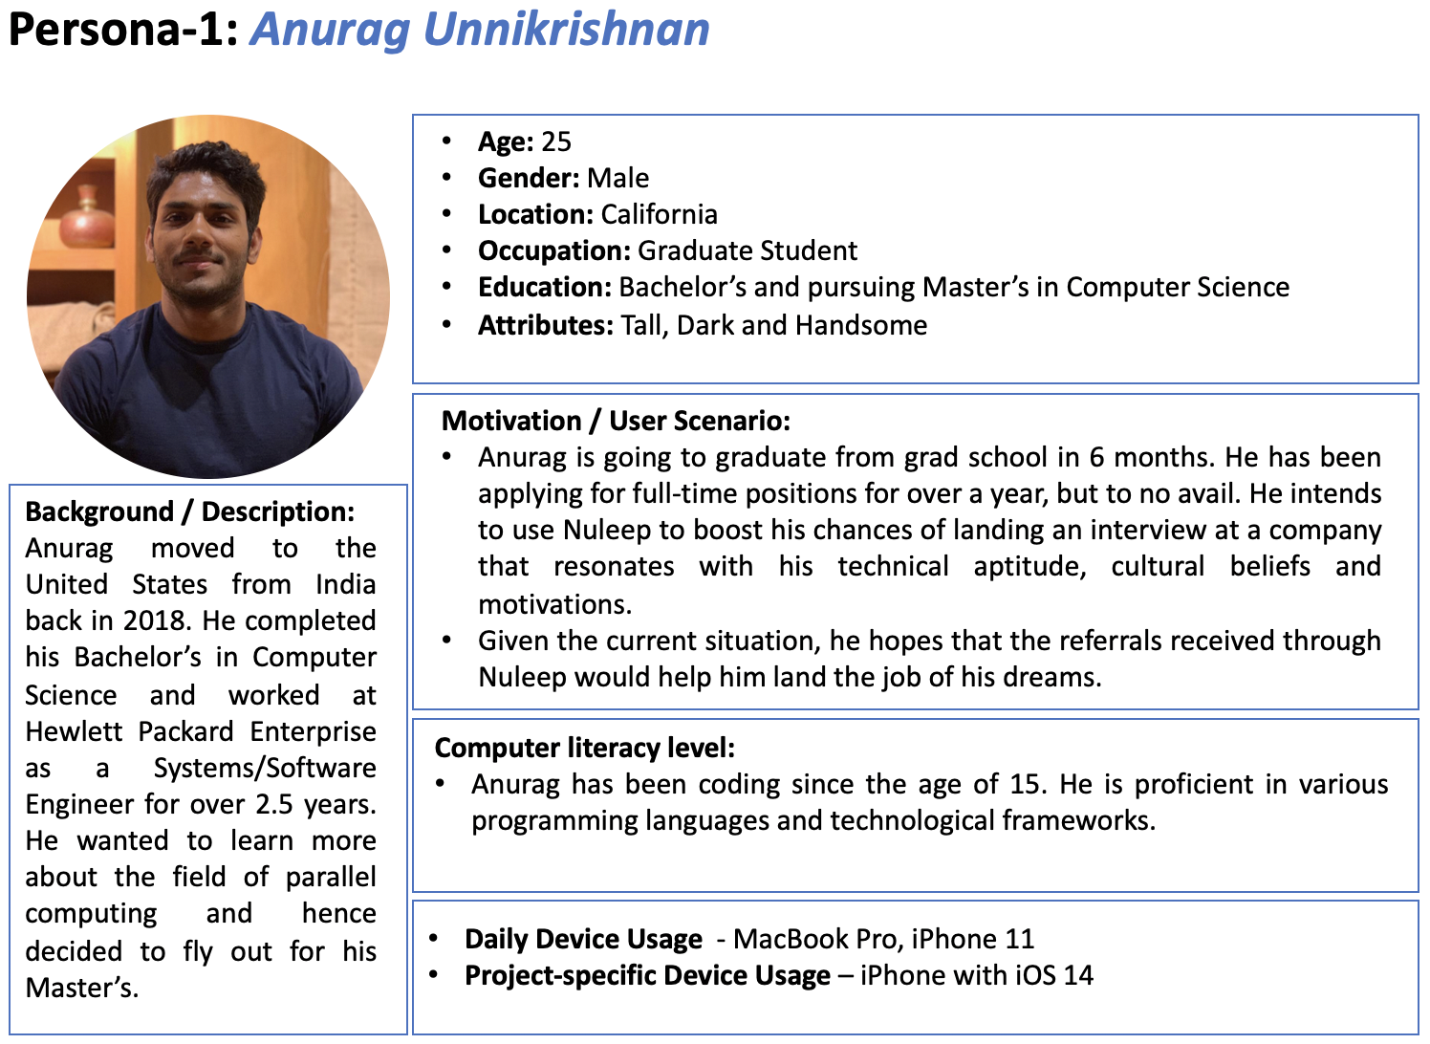
Personas
Personas are used to establish the potential users of the system

Slide 50
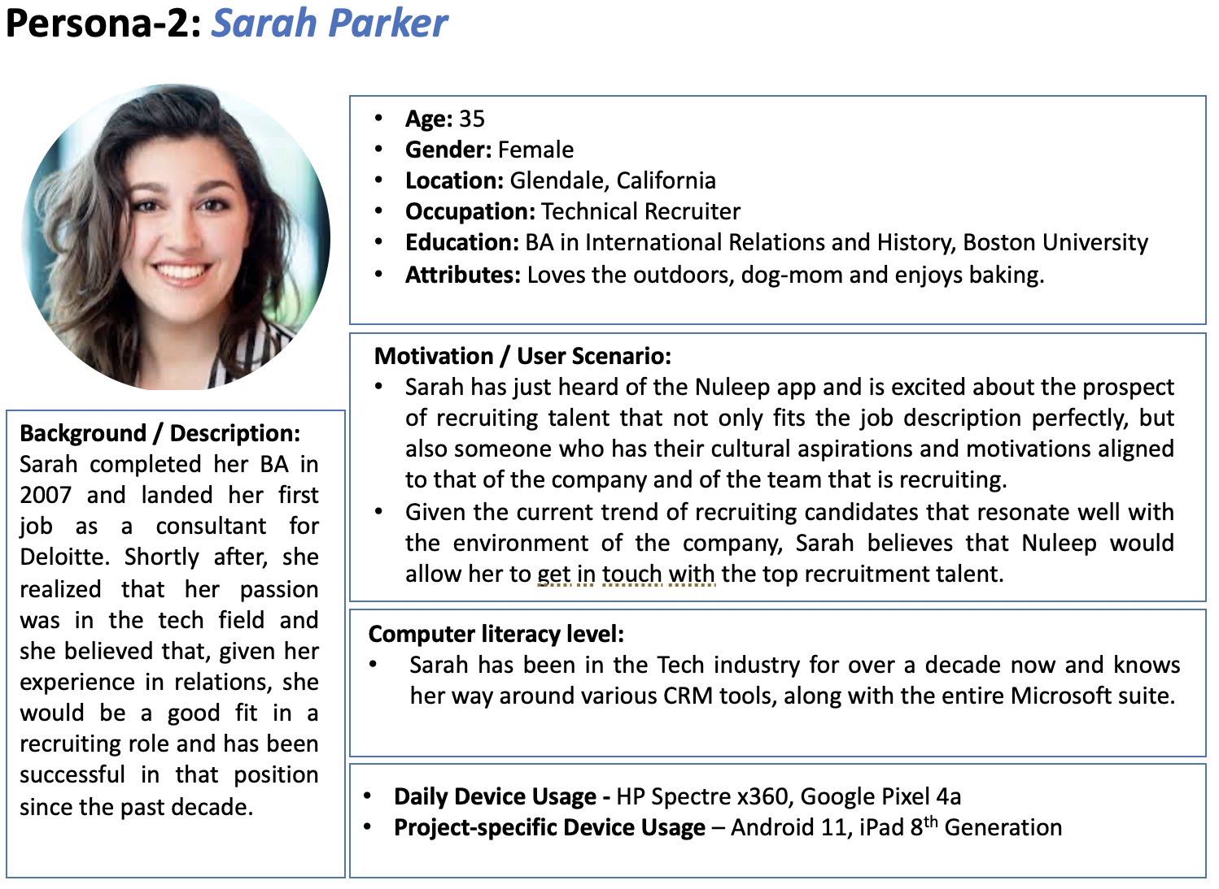
Personas
Personas are used to establish the potential users of the system

Slide 51
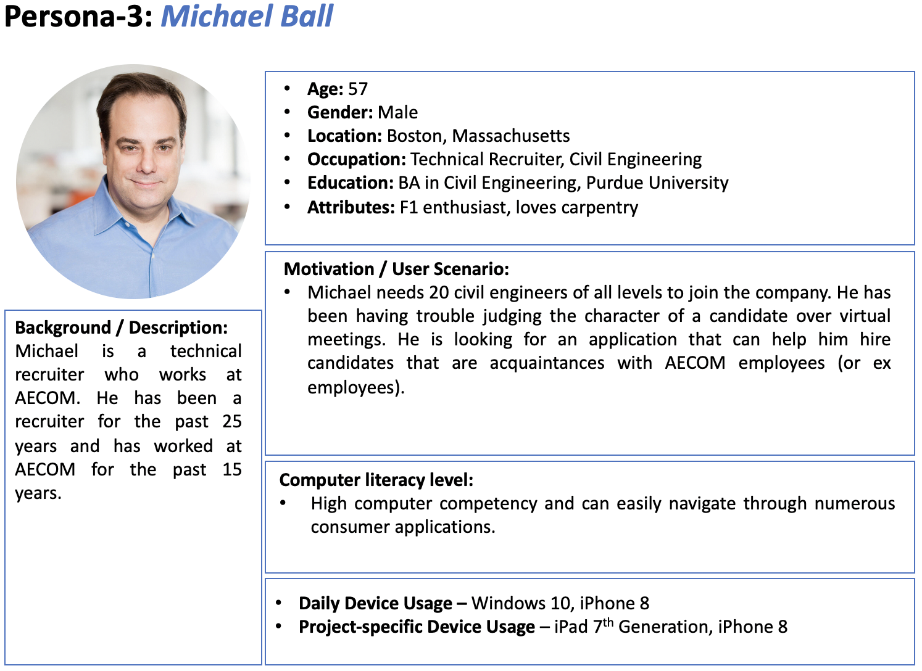
Personas
Personas are used to establish the potential users of the system

Slide 52
QFP

Slide 53
QFP
Traceability Matrix
Defect Identification
Quality Management Strategy
Technical Debt

Slide 54
Traceability Matrix
OCD | Win condition | Use case diagram | Test plan
Chat system | B8-B21 | Varies from team member | Team member testing
Referral system | B22-37 | Varies from team member | N/A

Slide 55
Defect Identification
 | Class diagram | Sequence diagram | Use case diagram
Review | Peer review | Peer review | Peer review
Grading | Yes | Yes | Yes
Client feedback | Yes | No | No

Slide 56
Quality Management
Trello:
Minimizing confusion around project assignments with simple tools to organize tasks and track progress.
Customizable lists and tasks
Team traceable by organization owner
Slack (Both client and team):
Easily switch between client chat and team chat
Different organization can use different email to sign in
Support external app(like zoom, Jira)

Slide 57
Technical Debt
Team
Hard coding the current chat system functionalities
AWS EC2 chat message shortage
Debt
Lack of repository documentation
Client
Code base delay

Slide 58
THANK YOU

